Slide 1
Bad SPL / Architecture
Kyle McCririe – Sales Engineer
May 19, 2020

Slide 2
Filter First!
Okay:
index=oidemo | search mem > 10 AND sourcetype="vmstat2"
Better:
index=oidemo sourcetype="vmstat2" mem>10
Does it matter?

Slide 3
Top users who failed login to SQL
You have been tasked to get a list of the top users who have failed to login to mssql_1.
Bad:
mssql_1 failure | table user
Better:
index=oidemo sourcetype=WinEventLog:Security host=mssql_1 action=failure | top limit=20 user

Slide 4
Count of failed logins for each admin
You have been tasked to get the count of all admins who have failed to login. Excluding admin 2
Bad:
*adm* *fail* NOT admin2 | count user
Better:
index=oidemo sourcetype=WinEventLog:Security action=failure user=adm* NOT admin2 | top user

Slide 5
Use a filtering command.
Okay:
index=oidemo host="mysql-02"
| table loadAvg1mi, mem, mem_free
| head 10000
| table loadAvg1mi, mem, mem_free
Better:
index=oidemo host="mysql-02"
| fields loadAvg1mi, mem, mem_free
| head 10000
| table loadAvg1mi, mem, mem_free

Slide 6
Stats VS Transaction
Careful! Stats may not always give same results as transaction.
Transaction:
index=oidemo sourcetype=access_combined
| transaction JSESSIONID
| chart count by duration
Stats:
index=oidemo sourcetype=access_combined
| stats range(_time) as duration by JSESSIONID
| chart count by duration

Slide 7
To join or not to join
Okay:
sourcetype=access_combined | join type=inner JSESSIONID [search sourcetype=applogs | dedup JSESSIONID | table JSESSIONID, clienip, othervalue]
Better:
sourcetype=access_combined OR sourcetype=applogs | stats latest(*) AS * BY JSESSIONID

Slide 8
When to use Stats/Transaction
https://docs.splunk.com/Documentation/Splunk/8.0.3/Search/Abouteventcorrelation

Slide 9
Bonus: Calculate duration of each event.
This is a bonus challenge that will require some advanced SPL.
You have tasked with taking some ATM data and figuring out the duration of each event.
`ATM_Base`
| sort -_time
| streamstats window=2 first(_time) as NextStepTime, last(_time) as StepTime, first(sName) as NextStep, first(GUID) as NextID
| eval duration_seconds = if(GUID != NextID, 0, (NextStepTime - StepTime) )
| table GUID, NextID, sName, NextStep, _time, StepTime, NextStepTime, duration_seconds, Name, Size, State
| sort _time | search GUID=*
| eval duration_ms = (duration_seconds*1000)
| table _time, sName, GUID, duration_ms

Slide 10
You can comment!
source=usgs `comment("source is the us geological service (usgs)")` | eval Description=case(depth<=70, "Shallow", depth>70 AND depth<=300, "Mid", depth>300, "Deep") `comment("Creates field Description. Case function specifies earthquake depths, returns Description values - Shallow, Mid, Deep.")` | stats count min(mag) max(mag) `comment("Counts earthquakes, displays min and max magnitudes")` BY Description

Slide 11
Search Tips
Avoid | Explanation | Suggested Alternative
All Time | Events are grouped by time Reduce searched buckets by being specific about time | Use a specific time range Narrow the time range as much as possible
index=* | Events are grouped into indexes Reduce searched buckets by specifying an index | Always specify an index in your search
Wildcards | Wildcards are not compatible with Bloom Filters Wildcard matching of terms in the index takes time Lexicon is structured by common prefixes, so appending an * is best (if you have to do it) | Varying levels of efficiency > myterm* → Not great > *myterm → Bad > *myterm* → Death Use the OR operator i.e.: MyTerm1 OR MyTerm2
Notes:
All Time
- Narrow your time range
Index=*
- Reduce buckets searched by specifying index(es)
Wildcards
- Not compatible with bloom filters
- Depending on the placement, may cause a “brute force” search of the raw data

Slide 12
Search Tips
Avoid | Explanation | Suggested Alternative
NOT != | Bloom filters & indexes are designed to quickly locate terms that exist Searching for terms that don’t exist takes longer | Use the OR/AND operators (host=c OR host=d) (host=f AND host=h) vs. (host!=a host!=b) NOT host=a host=b
Verbose Search Mode | Verbose search mode causes full event data to be sent to the search head, even if it isn’t needed | Use Smart Mode or Fast Mode
Real-time Searches | RT Searches put an increased load on search head and indexers The same effect can typically be accomplished with a 1 min. or 5 min. scheduled search | Use a scheduled search that occurs more frequently Use Indexed-Realtime searches (Set by Splunk admin)
Notes:
NOT/!=
- Bloom Filters/Indexes are tuned to look for things that exist not things that don’t exist
- Can cause Splunk to serially scan through buckets
- Use OR/AND instead of NOT
Verbose Search Mode
- Only use this when testing
- Returns unnecessary event data to search head
Realtime Searches
- Spawns additional processes on the indexers
- Scheduled searches can typically accomplish the same thing

Slide 13
Search Tips
Avoid | Explanation | Suggested Alternative
Transaction | Not distributed to indexers Typically only needed if using additional parameters (maxSpan, startsWith, etc…) | Use the stats command to link events where possible
Joins/Sub-searches | Joins can be used to link events by a common field value, but this is an intensive search command | Use the stats (preferred) or transaction command to link events
Search after first | | Filtering search results using a second “| search” command in your query is inefficient | As much as possible, add all filtering criteria before the first | i.e.: >index=main foo bar vs. >index=main foo | search bar
Notes:
Transaction
- Very intensive command that does not distribute
- The same results can typically be achieved using stats unless you need additional parameters like maxSpan, maxPause, startsWith, endsWith, etc….
Joins/Subsearches
- Intensive command
- Stats (preferred) or transaction can typically do the same thing
Search after first |
- Filter as much as possible before the first pipe
- Less data is retrieved from indexers

Slide 14
Some useful SPLs…
SPL | Explanation | Example
Subsearch | Parameterize one search, using the output of another search. Use when parameter values change | sourcetype=kepware [search sourcetype=kepware earliest=-1h | top limit=1 host | fields + host] Subsearch is executed first and provides parameter value. Main Search uses the parameter value.
join | Join will combine the results of a subsearch with results of a main search Limits are imposed on subsearch # of returned results & time | ... | join product_id [search vendors] Note: Can be expensive, consider stats command if your join SPL is slow of won’t complete
regex | Keep the events that match and remove the ones that don’t match, from the result set | ... | regex _raw="(?<!\d)10\.\d{1,3}\.\d{1,3}\.\d{1,3}(?!\d)” Above example uses a negative lookbehind assertion at the beginning of the expression. It states: Keep only events whose "_raw" field contains IP addresses in the non-routable class A (10.0.0.0/8)
rex | Extract fields from event or find/replace values using sed expressions | Ad hoc field extraction Anonymize/obfuscate field values in search result sets
erex | Don’t know regex, use erex Regex can be found in the Job Inspector | ... | erex monthday examples="7/01, 07/02" counterexamples="99/2” ... | erex monthday examples="7/01”

Slide 15
The TERM Directive
Why does it matter?
Lexicon
Splunk breaks terms by Major and Minor Segmenters
When writing to the TSIDX and searching
Default minor segmenters: / : = @ . - $ # % \\ _
TERM prevents breaking on Minor segmenters
Term | Postings List
0 | 0
6 | 0
9 | 1
10 | 0
28 | 1
2016 | 1
10.0.0.6 | 0
9/28/2016 | 1
com | 2
jeff | 2
splunk | 2
jeff@splunk.com | 2
Raw Events
10.0.0.6
9/28/2016
jeff@splunk.com
Notes:
Concept of segmentors -- (.;-) the way we separate the data in indexes
put the whole thing in a term, its much more efficient than searching wo the term operator

Slide 16
The TERM Directive
How do I use it?
ip=TERM(10.0.0.6)
ip 10.0.0.6 - 807256800 GET /images/launchlogo.gif
TERM(ip=10.0.0.6)
ip=10.0.0.6 - 807256804 GET /shuttle/missions.html
TERM(ip10.0.0.6)
ip10.0.0.6 - 807256944 GET /history/history.html
TERM(10.0.0.6*)
10.0.0.6:80 - 807256966 GET /skylab/skylab-4.html
TERM(“Willy Wonka”)
X
9/28/16 1:30 PM - name=Willy Wonka sex=m age=46
Your term MUST be bounded by major segmenters
Example: Spaces, tabs, carriage returns
See Segmenters.conf spec for full details
Your term cannot contain major segmenters
Notes:
Whole term searching
You need to know the format of your data before using this command
Must be bounded by major segmenters
Useful when your value has minor segmenters

Slide 17
Takeaways – Search Tips
Easy…
Limit your time window
Use specific index names
Look for things that do exist, rather than don’t (include vs exclude)
Filter & prune results early in your search
Keep it clean. Put commands on new lines.
Medium…
Substitute expensive commands with non-expensive SPL commands
GOAL: Fulfill the search while touching the fewest number of buckets possible
Fewer buckets = less data searched = faster search
Use TERM, tstats, metadata whenever you can
Tstats is a super-fast command; doesn’t search or return raw data
Tstats can be used on report/data-model accelerations AND indexed extractions
| metadata type=hosts | rex field=host "(?<shortHost>[^.]+)$" | rex
field=host "(?<shortHost>[^.]+)\." | dedup shortHost | table shortHost
Use default field-extractions whenever possible, e.g. source, host, sourcetype (special key-value pairs stored in TSIDX
Advanced…
Refactor searches to take full advantage of Indexers (distributable, centralized, transforming)

Slide 18
References
Write Better Searches http://docs.splunk.com/Documentation/Splunk/latest/Search/Writebettersearches
Wiki: How Distributed Search Works http://wiki.splunk.com/Community:HowDistSearchWorks
Splunk Search Types http://docs.splunk.com/Documentation/Splunk/latest/Capacity/HowsearchtypesaffectSplunkEnterpriseperformance
Search Commands by Type (Centralized vs. Distributed) http://docs.splunk.com/Documentation/Splunk/latest/SearchReference/Commandsbytype
Blog: When to use Transaction and when to use Stats http://blogs.splunk.com/2012/11/29/book-excerpt-when-to-use-transaction-and-when-to-use-stats/
Segmenters.conf Spec http://docs.splunk.com/Documentation/Splunk/latest/Admin/Segmentersconf
Splunk Book – Exploring Splunk: http://www.splunk.com/goto/book
ML in Splunk: SPLs for Finding Anomalies & Predictive Analytics
GoSplunk – A Splunk Query Repository: https://gosplunk.com
Search Command Cheat Sheet: https://docs.splunk.com/images/a/a3/Splunk_4.x_cheatsheet.pdf
Splunk Quick Reference Guide: https://www.splunk.com/pdfs/solution-guides/splunk-quick-reference-guide.pdf
How Bloom Filters Work – An Interactive Demo: https://www.jasondavies.com/bloomfilter/
Looking for Search Efficiency: David Paper’s Search Reporting Dashboard XML
Search Capability and Activity Monitoring: https://splunkbase.splunk.com/app/2632/
Notes:
Concept of search hygiene process (every 90 days -> MC to search for most resource consuming searches)
Strict promotion processes
A lot of folks using splunk that arent super trained -- heres how -- to rein that in
Poorly managed searches
Popularly accessed sourctypes or indexes

Slide 19
Architecture

Slide 20
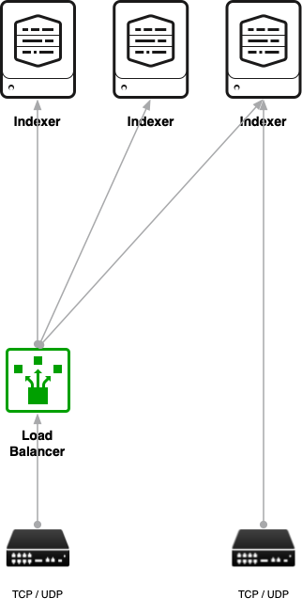
Direct TCP / UDP

Slide 21
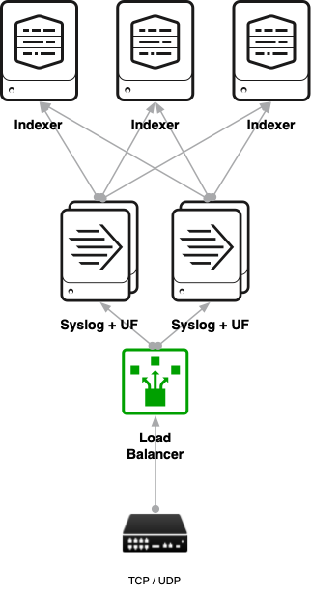
Syslog Best practice

Slide 22
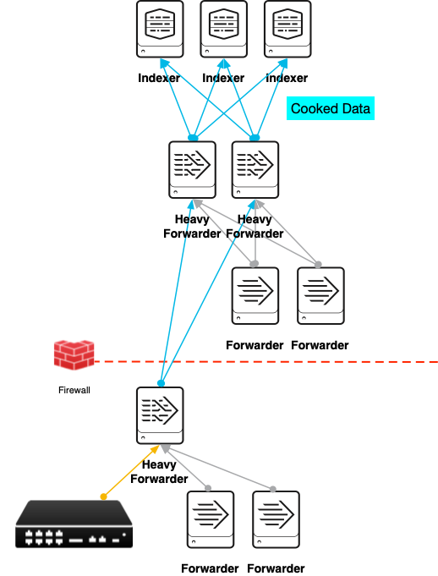
Avoid Bottlenecks
Intermediate Forwarders
No data is being sent directly to indexers
HWF are used when UFs will do
Avoid data funnels
Forwarders sending data to a handful of intermediate forwarders
This causes indexer starvation
Indexers aren’t receiving events for periods of time
Results in data imbalance and poor search performance

Slide 23
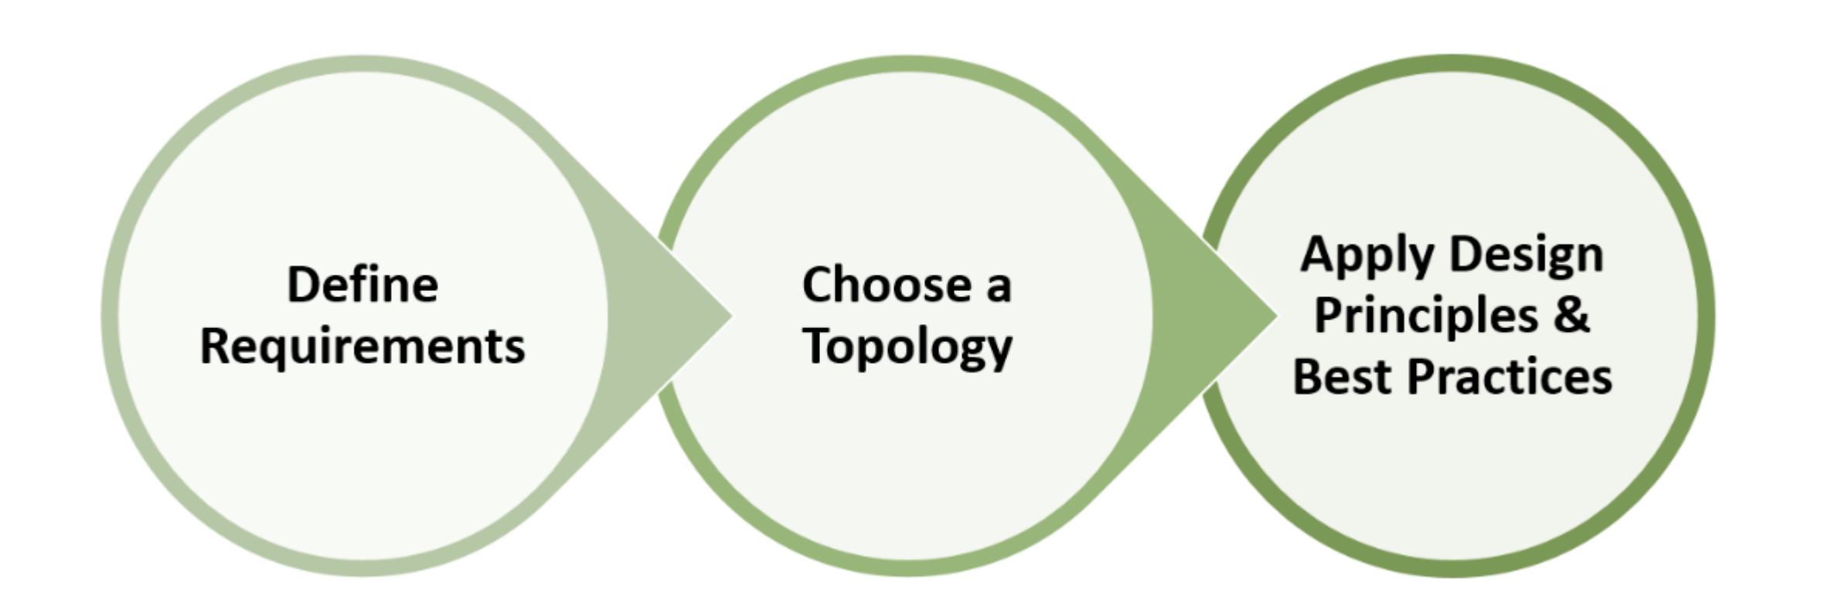
Splunk Validated Architectures
https://www.splunk.com/pdfs/technical-briefs/splunk-validated-architectures.pdf

